Slide 1
Generic classes & Methods
Ashlee Gaskins | Brittany Jennette | Ryan Tolentino| Java 204

Slide 2
Java? Hot Coffee…?
What is it?

Slide 3
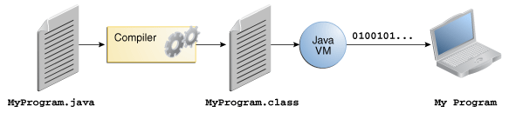
Under the hood…

Slide 4
Project Overview
Java Classes
Example
Blueprint or a template for creating different objects which defines its properties and behaviors
Objects exhibit the properties and behaviors defined by its class
Classes can contain fields and methods to describe the behavior of an object.
For example, there may be thousands of bicycles in existence, all of different make and model. Each bicycle was built from the same set of blueprints and therefore contains the same components.
Class Bicycle{
int cadence = 0;
int gear = 1;
void changeCadence(int newValue){
cadence = newValue;}
void changeGear(int newValue){
gear = newValue;}
Void printStates(){
System.out.println(“cadence:” + cadence + “gear:” + gear);
}
}

Slide 5
Project Overview
Java Methods
Example
A method is a collection of statements that are grouped together to perform an operation.
The only required elements of a method are the methods return type, name, a pair of parentheses and a body between braces.
Methods can contain modifiers such as private, public, protected and more.
public double calculateAnswer( double wingspan, int numberOfEngines, double length, double grossTons){
System.out.println((wingspan* length)* (numberOfEngines/grossTons)
}

Slide 6
Naming a method 101
Although a method name can be any legal identifier, code conventions restrict method names
Method names should be a verb in lowercase or a multi-word name that begins in lower case followed by adjectives, nouns, etc.
In multi-word names, the first letter of each of the second and following words should be capitalized.
Examples:
runFast
getBackground
SetY

Slide 7
Overloading methods
The Java programming language supports overloading methods.
Java can distinguish between methods with different method signatures. Meaning, methods within a class can have the same name if they have different parameter lists.
public class DataArtist {
...
public void draw(String s) {
...
}
public void draw(int i) {
...
}
public void draw(double f) {
...
}
public void draw(int i, double f) {
...
}
}

Slide 8
Putting it all together
Library
Collection of packages
Packages
Collection of several classes
Classes
Methods

Slide 9
Java vs. Python
In Java, all variable names (along with their types) must be explicitly declared.
Not compact in programming
Static typing
Java uses curly braces to define the beginning and end of each function and class definition.
Java can be used to create platform-independent applications.
In Python, you never declare anything. An assignment statement binds a name to an object, and the object can be of any type.
Compact programming
Dynamic typing
Python uses indentation to separate code into blocks
Python programs you need a compiler that can turn Python code into code that your particular operating system can understand.

Slide 10
Java vs. python: classes
Python
Classes are a way of aggregating similar data and functions. A class is basically a scope inside which various code (especially function definitions) is executed, and the locals to this scope become attributes of the class, and of any objects constructed by this class. An object constructed by a class is called an instance of that class.
class Myclass
I =12345
def f(self):
return ‘hello world’

Slide 11
Java vs. python: methods
Python
A method is a function within a class. The first argument (methods must always take at least one argument) is always the instance of the class on which the function is invoked.
class Foo:
def setx(self,x):
self.x= x
def car(self):
print self.x
Calling a method is much like calling a function, but instead of passing the instance as the first parameter like the list of formal parameters suggests, use the function as an attribute of the instance.

Slide 12

Painting the picture…
Three friends from the U.S. decide to take a road trip to the lovely land of Canada. The problem they face is no one knows the currency conversion for their dream destination! No worries, three other friends based in North Carolina have created a Java program to solve their exact problem. Let’s take a look…

Slide 13
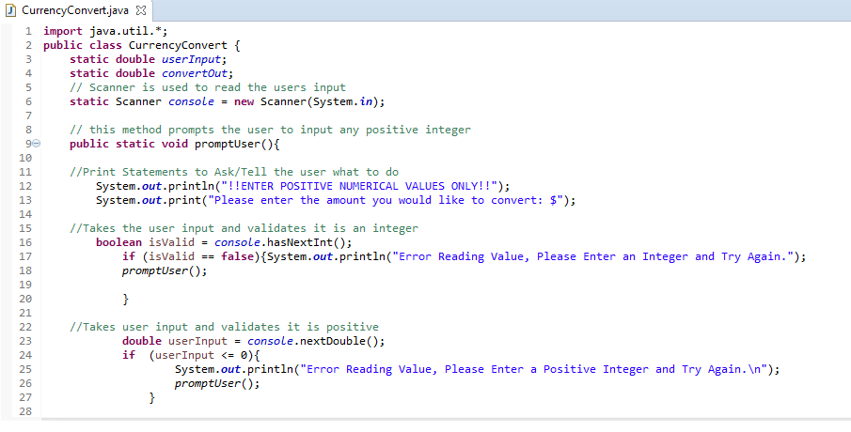
Currency converter
To left is an image line 1-28 of the code our team wrote. This portion of the program prompts the user to input a US dollar amount and prints the value of that amount in Canadian Currency. It also checks to make sure the value entered is valid (Positive Integer).

Slide 14
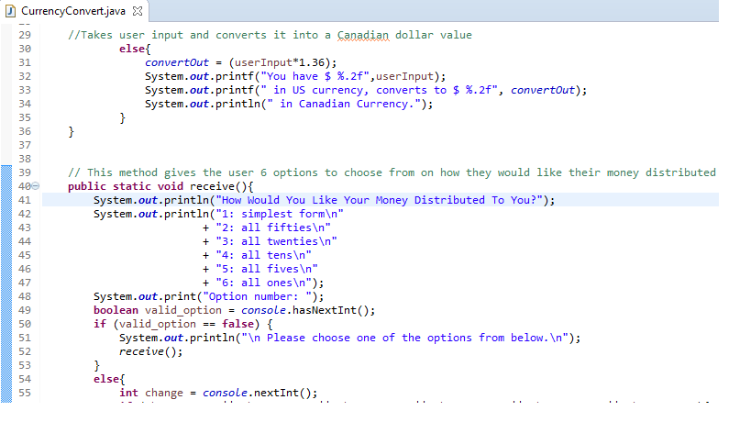
Currency converter
This next image is of lines 29-55. This part of the code is where the user input is converted into the Canadian Currency value. This also shows the different options the user has in how they would like their monies distributed to them.

Slide 15
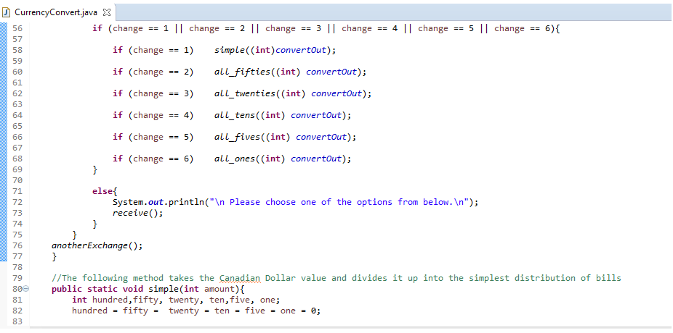
Currency converter
The lines 56-83 which are displayed in the picture to the left are a continuation of the options the user is given on how they would like their monies distributed. Using If statements to differentiate between which option (1-6) the user chose.

Slide 16
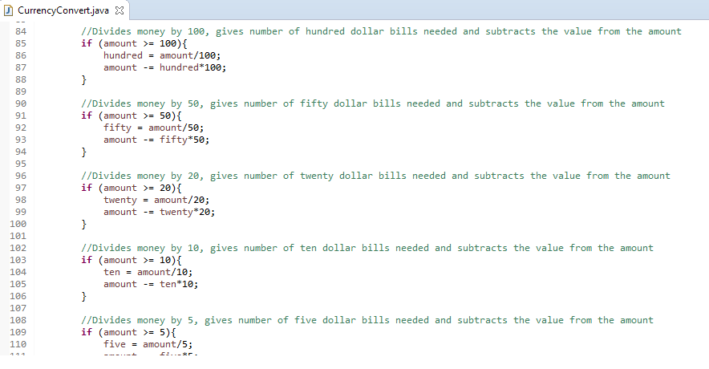
Currency converter
The lines 84-259 are all about how the money will be distributed as you can see in the set of code provided we used simple if statements to determine how to distribute the money and how many bills would be given to the user.

Slide 17
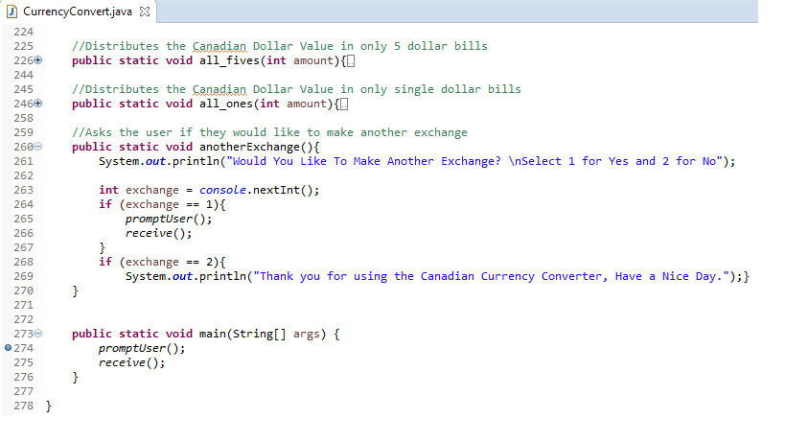
Currency converter
The lines 260-270 ask the user if they would like to make another currency exchange. If the user selects 1 for yes the user is prompted to do the program again. If the user selects 2 for no they are left with a friendly message and the program ends.
The Main function simply calls the methods for the program to run.

Slide 18
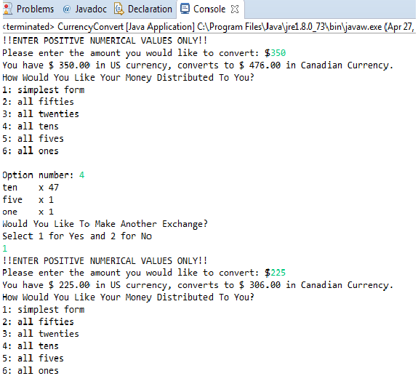
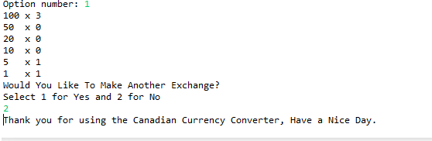
The Program in Action
This is an example of how the program runs. Please note the Prompts and user input.

Slide 19
Summary
Java is a widely used programming language. One of the main reasons java is so popular is its platform independence, which means that java programs can be run on many different types of computers. A java program runs on any computer with a java runtime environment, also known as a JRE, installed. Methods and classes are the building blocks for a java program. In order to be successful in the language, remember the basic syntax, naming rules and always explore the features.

Slide 20
References
Affiliates, O. &. (2017, April 26). The Java™ Tutorials. Retrieved from Oracle: https://www.oracle.com/java/index.html
Harvey Deitel, P. D. (2014). Deitel Java How to Program, 10th Edition. Pearson.

Slide 21

Special Thanks to…
Dr. Chekad Sarami for providing lecture slides as the foundation of our knowledge.
Google for always providing clarity for our gray areas of information.
Each team member for hours dedicated to research and coding.

Slide 22
Link to Github Repository
https://github.com/TolentinoDev/java_classes_and_methods

